Slide 1
Christ-Centered Product DESIGN Principles
A guide with key principles and underlying questions to consider when designing products and services.

Slide 2
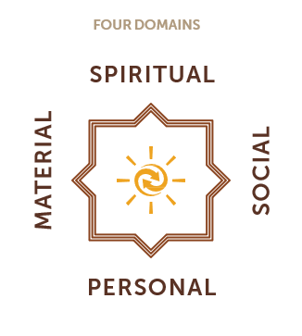
Why Christ-centered design principles?
At HOPE we are called to bear witness to Christ and His Kingdom through how we work. A key part of this is designing our products and services to intentionally bear witness to Christ and His Kingdom. We design our products and services to contribute to impact in four domains.
The key question that the principles in this ppt help us to address is:
How can we design this product to contribute to holistic client impact, including spiritual impact?
The principles and underlying questions in this ppt are available as a resource in the design process. It is recommended that the outcomes of the design process be reflected in the product card by including a “Christ-centered strategy” or “holistic impact” section in the product card.

Slide 3
Christ-centered products and services at HOPE
Christ-centered products and services
Christ-centered products give clients the opportunity to encounter Christ and His Kingdom and have a clear pathway for clients to engage in the client spiritual journey.
Christ-centered products have a clear SI strategy that fits with clients’ religious background, context, and needs.
Key Questions
What are the potential clients’ religious background, context, and needs?
What opportunities are there for clients to encounter Christ and His Kingdom through this product?
What opportunities do we have to invite clients to engage in the client spiritual journey at our organization?
What is the SI strategy, and how has it been adapted to fit the religious background, context, and needs of the clients?

Slide 4
Appendix: Resources
Appendix A: Client Spiritual Journey
Appendix B: Spiritual Integration Framework
Appendix C: Practical Design Guidance

Slide 5
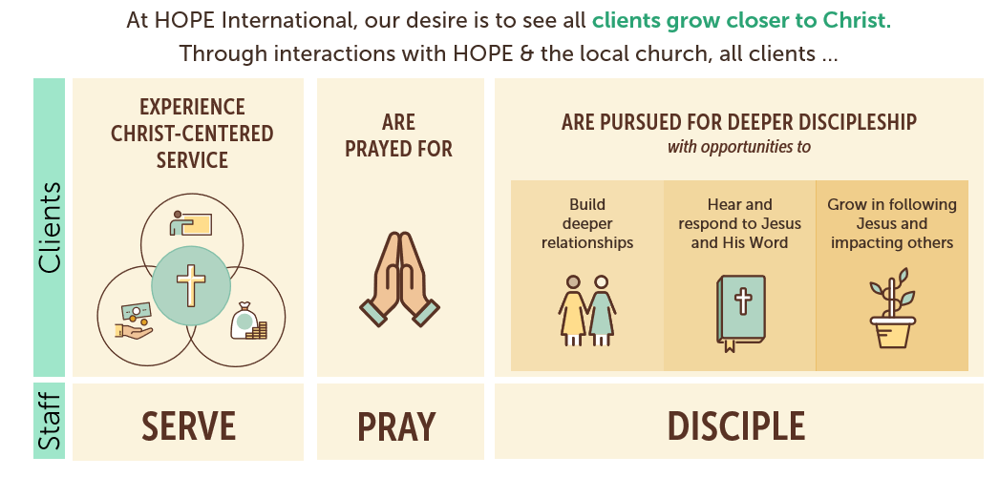
Appendix A: Client Spiritual Journey

Slide 6


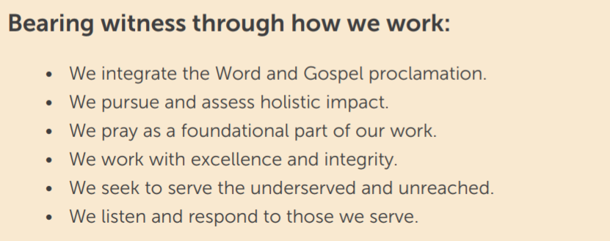
Appendix B: Spiritual Integration Framework
The SI Framework and principles for further guidance can be found here:
SI Framework Guide

Slide 7
Appendix C: Practical Design Guidance
Set aside time to pray and to listen to how the Spirit is guiding the design of this product.
Gather representative client feedback to understand the targeted clients & their context. Focus on the clients and step into their shoes. Conduct interviews and/or focus groups to hear from the prospective clients themselves as part of the design process.
Work through the design questions for Christ-centered products and services.
Consult with the Spiritual Integration team for feedback & support.
Prototype and test the product to gain feedback for improving the product.

