Slide 1
Christ-Centered Product DESIGN Principles
A guide with key principles and underlying questions to consider when designing products and services.

Slide 2
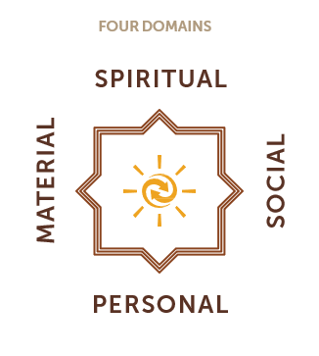
Why Christ-centered design principles?
At HOPE we are called to bear witness to Christ and His Kingdom through how we work. A key part of this is designing our products and services to intentionally bear witness to Christ and His Kingdom. We design our products and services to contribute to impact in four domains.
The key question that the principles in this ppt help us to address is:
How can we design this product to contribute to holistic client impact, including spiritual impact?
The principles and underlying questions in this ppt are available as a resource in the design process. It is recommended that the outcomes of the design process be reflected in the product card by including a “Christ-centered strategy” or “holistic impact” section in the product card.

Slide 3




Design Principles: characteristics of products and services at HOPE
Client-focused
Client-centered products are convenient and valuable to clients, provide opportunities for clients to fulfill their needs and desires, and abide by the client protection principles.
Christ-centered
Christ-centered products give clients the opportunity to encounter Christ and His Kingdom and have a clear pathway for clients to engage in the client spiritual journey.
Christ-centered products have a clear SI strategy that fits with clients’ religious background, context, and needs.
Missionally-aligned
Mission-aligned products contribute to holistic impact in the four domains of client’s lives (spiritual, material, personal, social). Where a particular product is stronger in one aspect of holistic impact than another, the product has a clear connection to other products that complement the product’s impact on clients.
Mission-aligned products serve clients in HOPE’s target market, particularly the least-served.
Sustainable
Sustainable products fit in the market context, are profitable, and are scalable to serve clients in the long run.

Slide 4
Questions to consider when designing products and services
Client-focused
Who is this product designed for?
What are the potential clients’ needs, desires, educational background, and existing product/service options?
How will this product meet the needs and desires of these potential clients?
What are the important moments in life for these clients that we can come alongside (for impact in all domains)?
How will this product honor client’s time?
Which of the client protection principles might be challenging to uphold as we implement this product? How will we mitigate this risk?
Christ-centered
What are the potential clients’ religious background, context, and needs?
What opportunities are there for clients to encounter Christ and His Kingdom through this product?
What opportunities do we have to invite clients to engage in the client spiritual transformation journey at our organization?
What is the SI strategy, and how has it been adapted to fit the religious background, context, and needs of the clients?
Sustainable
What is the market opportunity for this product?
How will this product be profitable/sustainable?
How will this product be scaled?
Missionally-aligned
How is this product designed to contribute to holistic impact (spiritual, material, personal, social) in clients’ lives?
How does this product serve clients in HOPE’s target market, particularly frontier populations?

Slide 5
DESIGN QUESTIONS
The following slides take the “questions to consider when designing products and services” from the previous slides and recommend when in the design process to focus on particular questions.

Slide 6
Understand clients at the beginning of the design process:
Who is this product designed for?
How does this product serve clients in HOPE’s target market, particularly frontier populations?
What are the potential clients’ needs, desires, educational background, and existing product/service options?
What are the potential clients’ religious background, context, and needs?
What are the important moments in life for these clients that we can come alongside (for impact in all domains)?
What is the market opportunity for this product?

Slide 7
Consider product details in the middle of the design process:
How will this product meet the needs and desires of potential clients?
How is this product designed to contribute to holistic impact (spiritual, material, personal, social) in clients’ lives? (directly or by connecting with other products and services at the organization)
What opportunities are there for clients to encounter Christ and His Kingdom through this product?
What opportunities do we have to invite the potential clients to engage in the overall “client spiritual transformation journey” at our organization?
What is the SI strategy? How has the SI strategy been adapted to fit the religious background, context, and needs of the clients?
How will this product be sustainable/profitable?

Slide 8
Additional considerations for later in the design process:
Which of the client protection principles might be challenging to uphold as we implement this product? How will we mitigate this risk?
How will this product honor client’s time?
How will this product be scaled?

Slide 9
Appendix: Resources
Appendix A: Client Spiritual Transformation Journey
Appendix B: Spiritual Integration Framework
Appendix C: Client Protection Principles
Appendix D: Practical Design Guidance

Slide 10
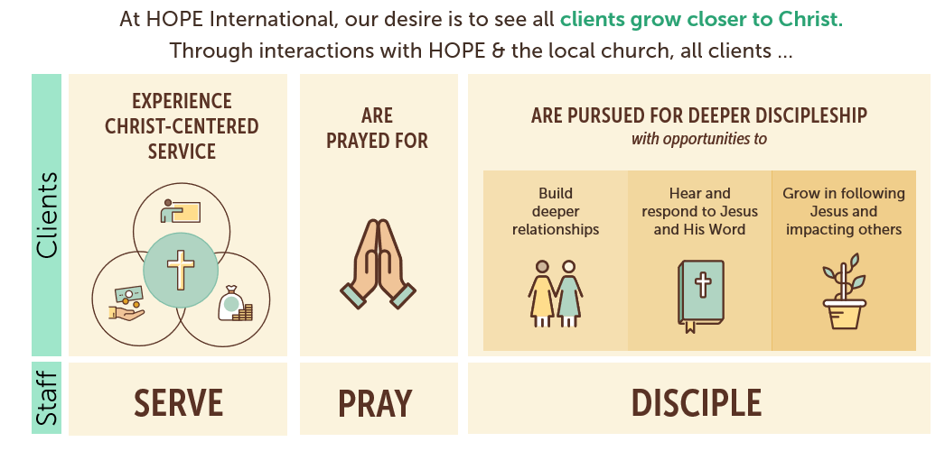
Appendix A: Client Spiritual Journey

Slide 11


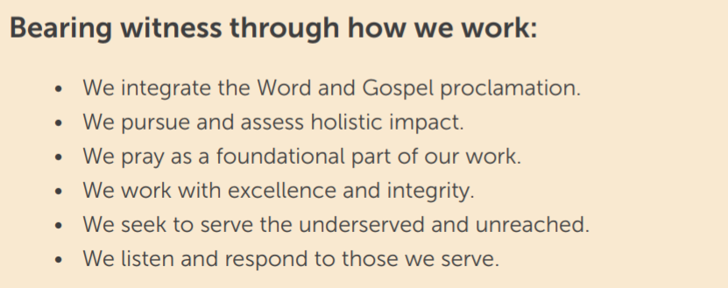
Appendix B: Spiritual Integration Framework
The SI Framework and principles for further guidance can be found here:
SI Framework Guide

Slide 12
Appendix C: Client Protection Principles
The Client Protection Principles articulate the standards of care that clients should expect to receive when doing business with a financial service provider. These principles were distilled from extensive work by many providers, networks, and supporting organizations. They represent a consensus view shared widely across the microfinance industry. Over 4,000 individuals, providers, institutions, regulators, and investors worldwide have endorsed these principles.
Client Protection Principles
Appropriate product design and delivery
Prevention of over-indebtedness
Transparency
Responsible pricing
Fair and respectful treatment of clients
Privacy of client data
Mechanisms for complaint resolution
*the smart campaign has ended and passed the work of furthering client protection principles to organizations like Cerise

Slide 13
Appendix D: Practical Design Guidance
Set aside time to pray and to listen to how the Spirit is guiding the design of this product.
Gather representative client feedback to understand the targeted clients & their context. Focus on the clients and step into their shoes. Conduct interviews and/or focus groups to hear from the prospective clients themselves as part of the design process.
Work through the design questions for Christ-centered products and services.
Consult with the Spiritual Integration team for feedback & support.
Prototype and test the product to gain feedback for improving the product.

